Slide 1



PRESENTATION BY
SNEHA S, MAHATHI B
musiQ
karaoke n learn

Slide 2

what is
karaoke
music ?!

Slide 3


“ Karaoke is singing along to a song without the original singer’s voice, so you can sing the lyrics yourself ”

Slide 4

FROM GENERIC TO PERSONAL SINGING PRACTICE
UNDERSTANDING CURRENT LIMITATIONS
SYSTEM GAP
Karaoke helps users sing a song. Learning tools help users practice. Very few experiences connect the two around the individual singer.
Current singing practices focus on fixed pitches. Beginners face challenges with complex phrases. Karaoke platforms prioritize performance over learning. Vocal practice tools often require teacher guidance. Individual vocal abilities are rarely considered.

Slide 5

PHASE 01 : EMPATHIZE

Slide 6

UNDERSTANDING OUR AUDIENCE
01
PRIMARY CONSUMERS
Beginner and amateur singers seek confidence and personalized practice to enhance their vocal skills, requiring simple guidance tailored to their unique learning needs.
02
SECONDARY CONSUMERS
Music learners and karaoke users desire easier song practice and flexible performance options, enabling them to enjoy singing while developing their musical abilities.
03
TERTIARY CONSUMERS
Vocal teachers and music academies benefit from structured practice and performance insights, allowing them to support their students more effectively in their musical journeys.

Slide 7


our research
method
what we wanted to understand
  Survey + User Interviews
  Empathy Mapping
  Pattern Identification
  How users currently use karaoke
  Difficulties they face while singing
  How they practice challenging sections
  How they choose the right pitch
  What kind of feedback they expect

Slide 8





RESEARCH FINDINGS INSIGHT
PITCH
PRACTICE
FEEDBACK
Different singers have unique vocal ranges, necessitating personalized pitch guidance for effective practice and improved singing proficiency.
Challenging song portions are often manually repeated; thus, we need section-wise
looping and tempo control to facilitate smoother learning.
Singers frequently rely on teachers or self- evaluation; accessible performance feedback is essential for fostering continual improvement and confidence in singing.

Slide 9


INSIDE THE SINGERS EXPERIENCE
BEGINNER SINGER
Beginners often feel confused and frustrated about their pitch, making it essential to provide clear guidance tailored to their needs.
AMATEUR SINGER
Amateur singers may feel restricted by song choices, highlighting the need for adaptable options that match their vocal comfort levels.
MUSIC LEARNER
Music learners frequently feel overwhelmed by fast- paced sections, necessitating techniques that simplify learning and enhance their practice experience.

Slide 10
empathy
maps

Slide 11

sriyaanchita
says :
This song is too high for me.
tHINKS :
Can I change the pitch?
DOES:
Searches for different versions of songs.
FEELS:
Restricted
Amateur Singer

Slide 12
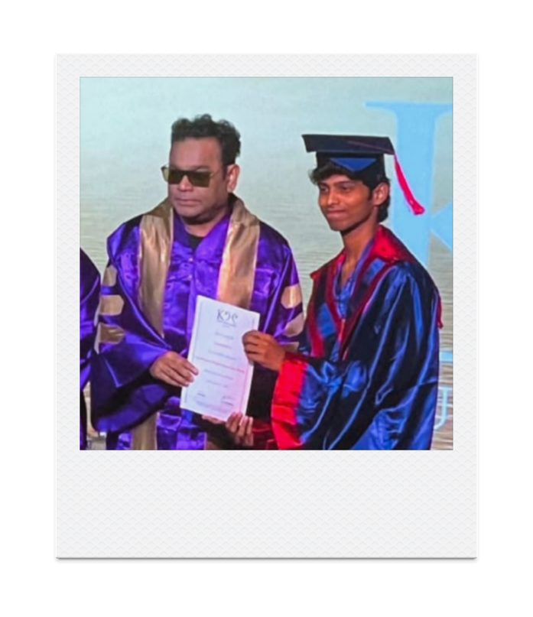
dhikshith
says :
This part is too fast.
tHINKS :
How do I learn this phrase?
DOES:
Repeats and slows difficult sections.
FEELS:
Frustrated
MUSIC LEARNER

Slide 13
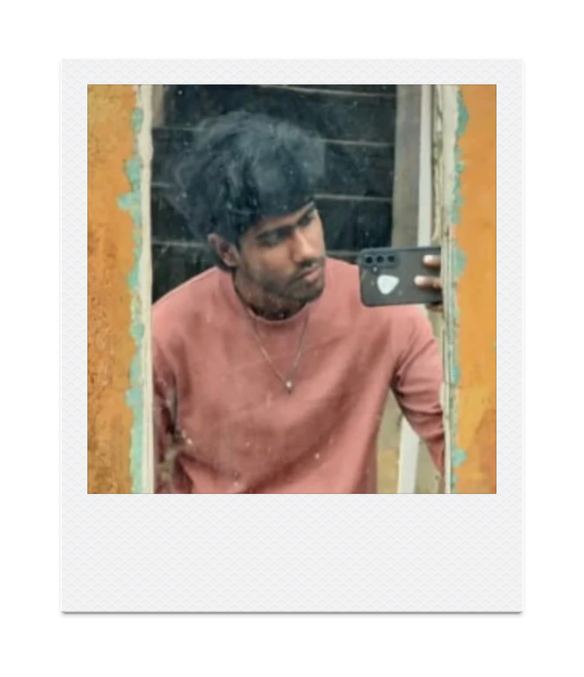
mukesh
says :
“I don't know if I'm singing correctly.”
tHINKS :
“Is this pitch suitable for me?”
DOES:
Repeats songs and follows tutorials.
FEELS:
Confused / hesitant.
BEGINNER SINGER

Slide 14
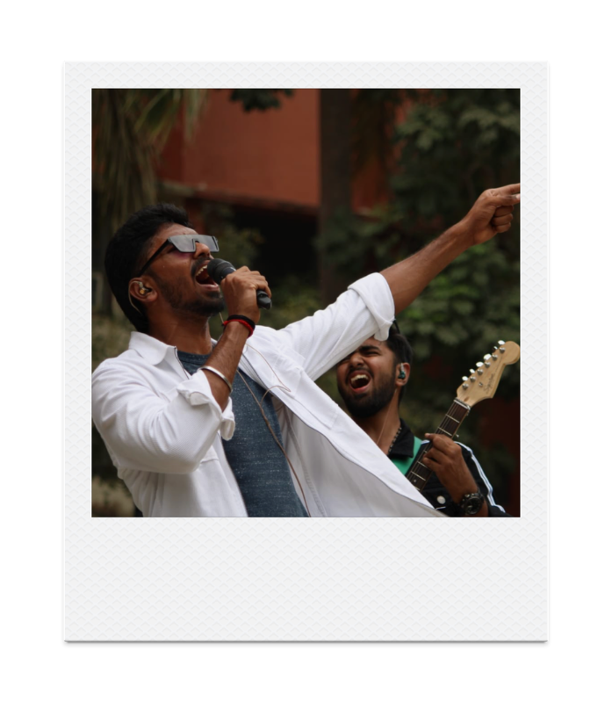
rethiCk RAGHAV
says :
“I want the music without the vocals.”
tHINKS :
“Can I customize the instrumental?”
DOES:
Searches for karaoke/instrumental versions.
FEELS:
Excited but limited by available
tracks.
KARAOKE USER

Slide 15
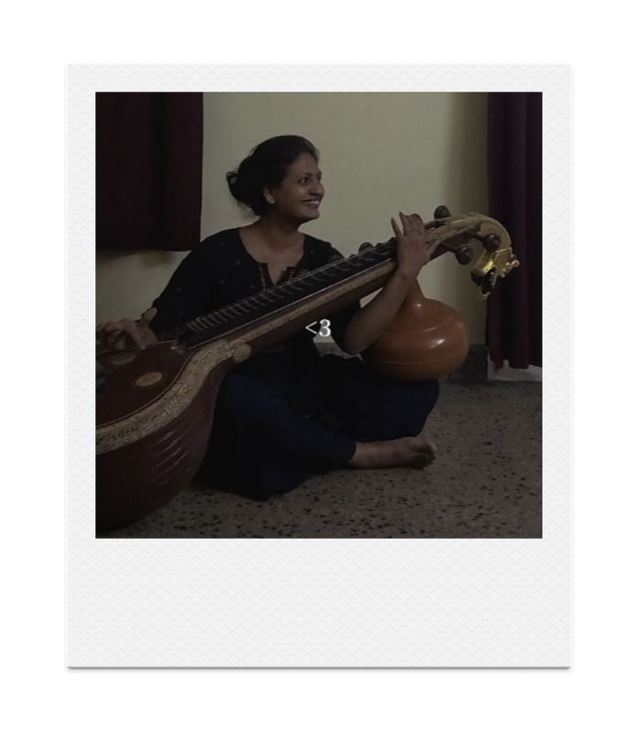
preethi sriram
says :
I want to know where I am going wrong
tHINKS :
“How accurate is my pitch?”
DOES:
Records and reviews their singing.
FEELS:
Curious / improvement-oriented.
professional

Slide 16
define

Slide 17

define
WHAT USERS NEED
WHAT WE UNDERSTAND
Personalized Karaoke
Users want karaoke that adapts to their vocal range instead of a fixed song key.
Control Over Music
Users want control over pitch, tempo and instrumental components to create a comfortable singing environment.
Better Singing Experience
Users want to record, layer and review their vocals with the instrumental track.
Practice Difficult Sections
Users need looping, tempo reduction and section-wise practice for challenging parts of a song.
Beginners need notes, lyrics and sangathi breakdowns to understand and practice complex portions.
Guided Learning

Slide 18
DEFINITIVE PROBLEM STATEMENT
Beginner and amateursingers
struggle to enjoy and improve their singing because existing karaoke and music-learning experiences rarely adapt to their individual vocal range, performance needs and learning level.

Slide 19
DEFINING THE PROBLEM
KEY CHALLENGES
Beginner and amateur singers face significant difficulties in practicing and performing due to a lack of personalized guidance and adaptation.
PERSONALIZATION GAPS
Existing music experiences often fail to adapt to the individual vocal ranges and learning needs of singers, resulting in ineffective practice sessions.

Slide 20
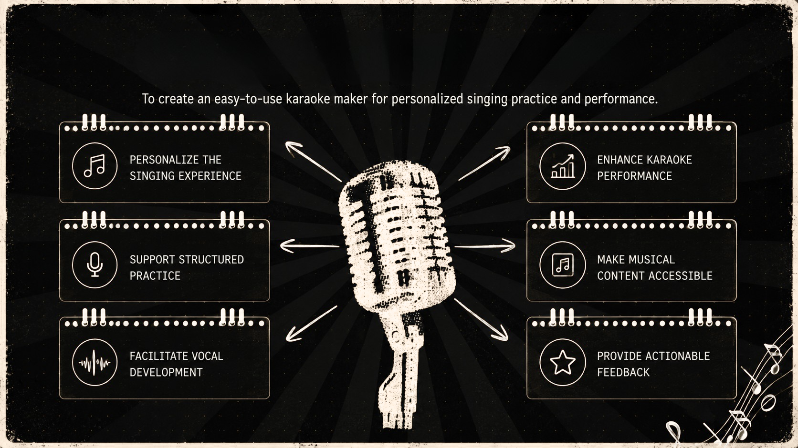
objectives

Slide 21
MUSIQ: Two Ways to Sing
LEARN BRANCH
The Learn branch offers vocal assessments, breathing exercises, and song practice, enhancing the user’s skill through structured guidance and personalized feedback.
KARAOKE BRANCH
In the Karaoke branch, users can input songs, customize karaoke tracks, and record their vocals, ensuring a fun and interactive singing experience.
VOICE ANALYSIS
Both branches integrate voice analysis, providing personalized recommendations that adapt future practice based on user performance for continuous improvement.

Slide 22
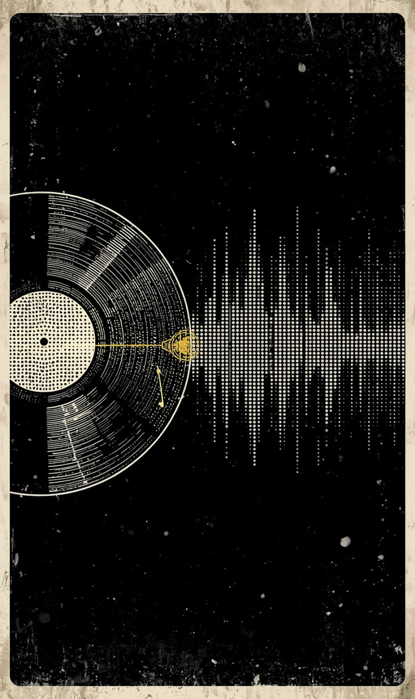
Proposed Architecture for MUSIQ
SIMPLIFYING USER EXPERIENCE
The MUSIQ architecture integrates user profiles, audio processing, and personalized feedback, creating a seamless learning and karaoke experience tailored to each singer's needs.

Slide 23
Contstraints
  Accuratevocal-range and pitch detection may vary with microphone
quality and background noise.
  Song pitch and tempo changes must maintain acceptable audio quality. Automatic stem separation may not produce perfectly isolated instruments. Sangathi and note detection can be challenging for complex or highly ornamented vocals.
  AI-generated recommendations depend on the quality and quantity of user performance data.
  Real-time audio processing may require significant computational resources. Accessing and processing songs from external platforms may involve copyright and platform restrictions.
  As a student project, development is constrained by limited time, technical expertise and computing resources.

Slide 24
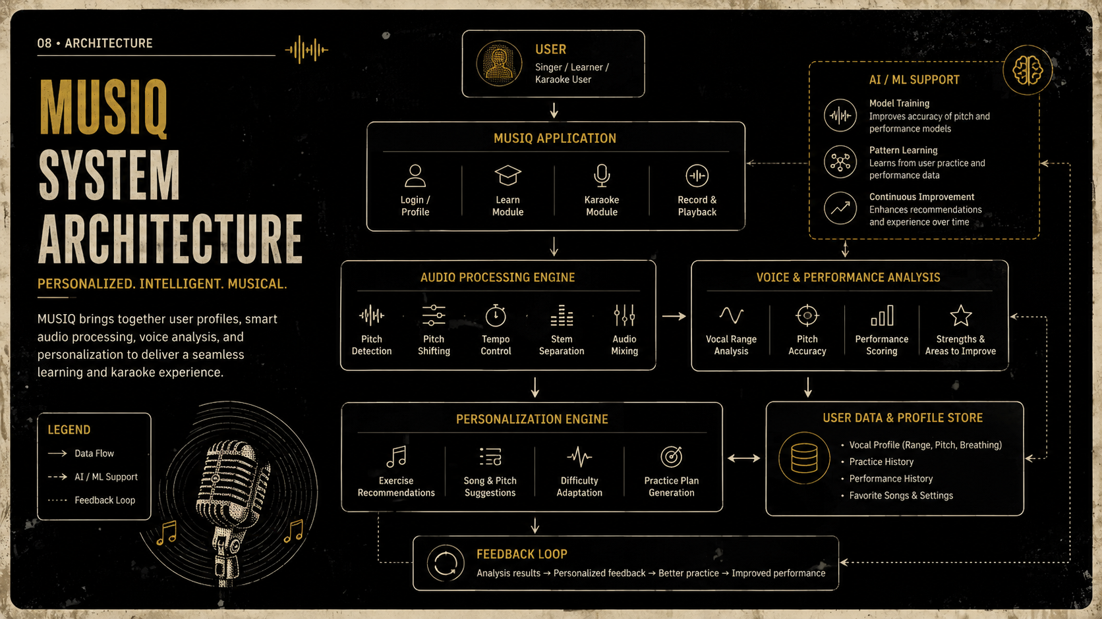

Slide 25
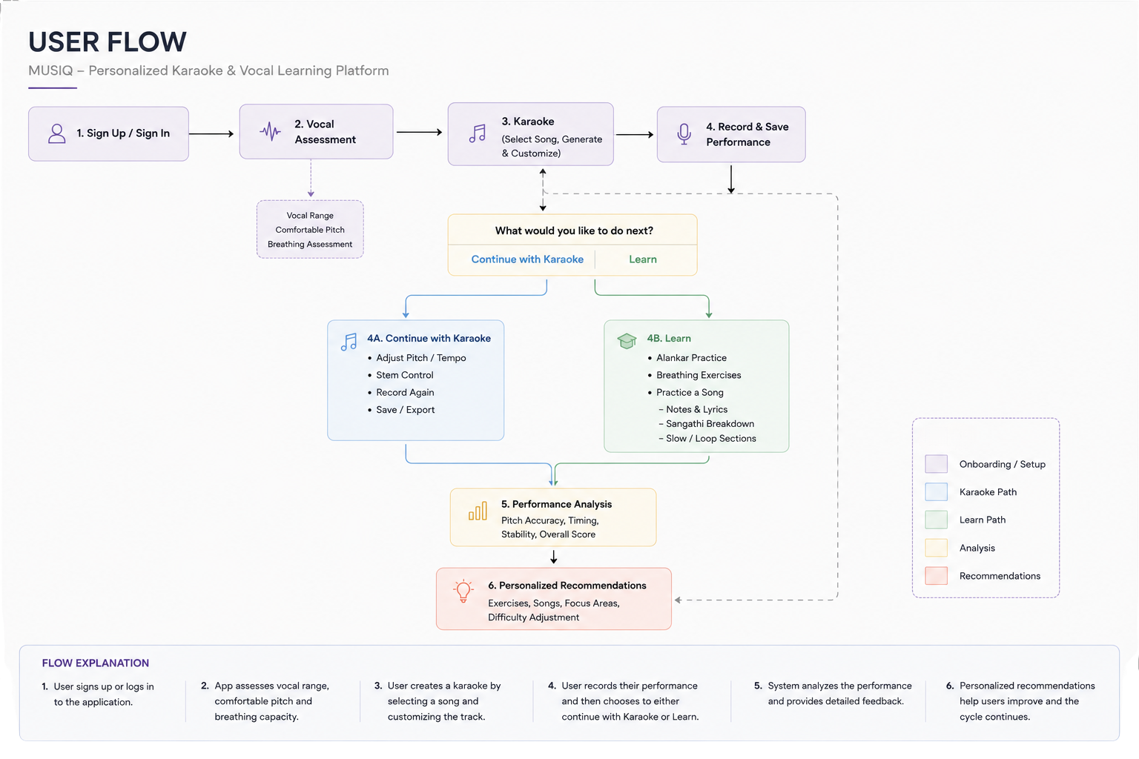
user flow diagram

Slide 26
PRESENTATION BY
SNEHA S, MAHATHI B
THANK
YOU

